Slide 1
Tutorial DAGS

Slide 2
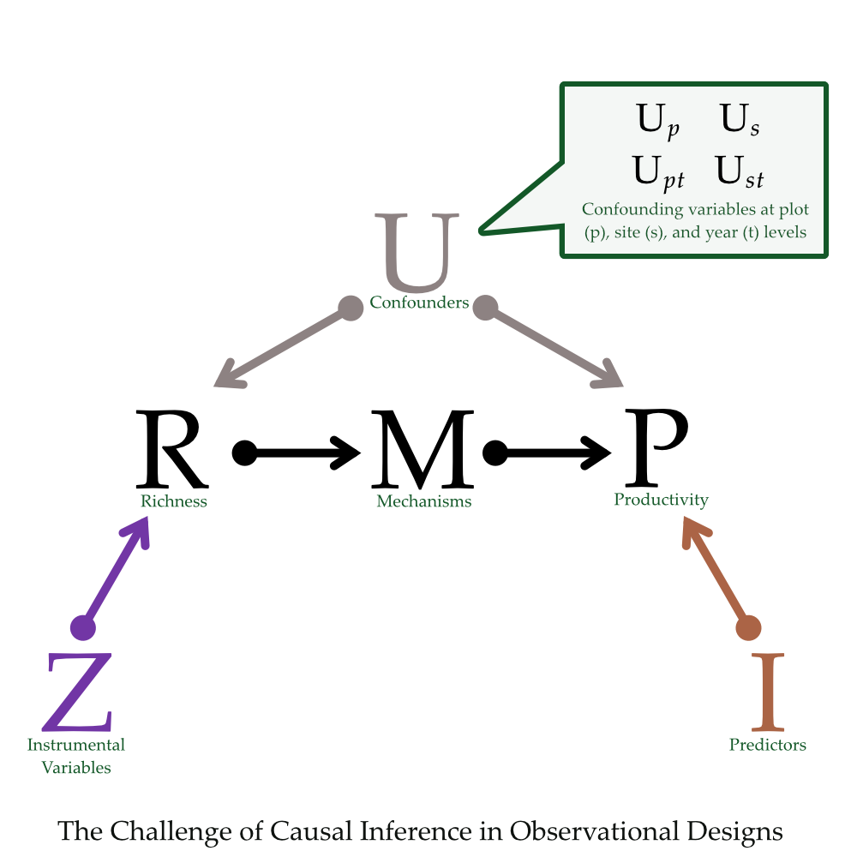
Conditioning on Observables
The other covariates (plot and site attributes) in a multivariate model.
X
Observed
Unobserved

Slide 3
Unobserved
Plot Fixed Effects
X

Slide 4
Unobserved
X
X
Plot Fixed Effects
and site-by-year effects
X

